Slide 1


Spectrum Virtualize For Cloud
A New SDS Practice in Hybrid Cloud
Zhang Yiming
China System Lab
IBM
Nov 2018

Slide 2
How Can Hybrid Cloud Help the Digital Transformation?
Data integration
Data Center Extension
Integrated Network
Integrated Identity and Access
Integrated resources and deployment management
Integrated Devices and Edge Systems
Cloud Bursting
Data migration and DR
Migrate data between on-premises storage and public cloud
Use public cloud storage as DR target
Extend on-premises storage
Use cloud storage for snapshots or archives of on-premises data
2018 IBM Corporation
Notes:
Key Takeaway:
To deliver greater business value in a digital world, every business is becoming an ecosystem. We extract new value both from a mix of third parties, and from our entire existing business.
Speaking Points:
To deliver greater business value, every business is becoming an ecosystem. We extract new value both from a mix of third parties and from our entire existing business. Hybrid cloud lets you realize that value best, through greater:
Speed: letting you change only what you need to change
Flexibility: letting you flexibly position workloads to best meet business objectives
Innovation: letting you leverage cloud services, open communities and emerging technologies like cognitive, blockchain, IoT, and more to maximize opportunity
Insight: letting you combine your existing data and processes with new sources of data to get to the best outcomes.
In fact, in our Institute for Business Value Study, 85% of leaders – in the study, we call them “frontrunners,” are seeing value from hybrid cloud in being able to leverage existing investments and at the same time get to the cloud. The value is not just in cost and speed, which are cloud givens, but also in the ability to realize new insights and innovation.
This is why IBM is pursuing a cloud-first strategy of connecting cloud to cloud, enterprise to cloud, app to app, data to app, or any of these combinations. We are making it easier for clients to move beyond just cost cutting and speed, to realize the innovation and insight needed to evolve business models in game changing ways.

Slide 3
Scenarios For Data Integration - Evolution
CSP
CSP2
CSP1
Data
Data
Data
Private Cloud
Hybrid Cloud
Federated Clouds
2018 IBM Corporation
6
Notes:
IBM Spectrum Virtualize software has been working on Hybrid cloud solutions that are now evolved from on premises deployments to taking advantage of public cloud IaaS. Today we support IBM Public cloud IaaS with IBM Spectrum Virtualize for Public Cloud – for DR and Workload Migration use cases. We are going to show you a TECHNOLOGY DEMONSTRATION today of our vision around a Federated Cloud solution with both IBM Cloud and AWS Cloud replicating data between each of them.

Slide 4


Have you heard about
?
Physical storage is “hidden” from servers
Enables rapid, flexible provisioning and simple configuration changes
Enables non disruptive movement of data among tiers of storage
Enables data placement optimization to improve performance
Rich integrated function applies to all storage
Functions including compression, replication, tiering, high availability, encryption, hybrid cloud
Single user interface to manage all storage, regardless of vendor
Move data transparently between different storage systems
Extend life and enhances value of existing storage assets
Delivers agility and efficiency of software-defined storage to existing and new storage at lower cost than replacement
Hitachi
EMC
NetApp
IBM
HP
Pure
Oracle
Notes:
IBM Spectrum Virtualize is Software Defined Storage for block or structured data. IBM is #1 in the industry in Software Defined Storage. Spectrum Virtualize has been in the market for over 12 years and has shipped to clients around the world in our family of Storwize storage appliances, IBM FlashSystem storage, and IBM SAN Volume Controller (SVC). These are both Enterprise and Mid market solutions that are shipped to Fortune 100 companies WW, as well as many commercial and midsize clients.
Over 159,000 Storwize systems and over 62,000 SVC engines shipped world-wide
Over 372,000 enclosures of data
Virtualizing, managing and securing 8.2 exabytes of data
Exceeding 99.999% availability
Supporting over 440 IBM and non-IBM storage systems

Slide 5

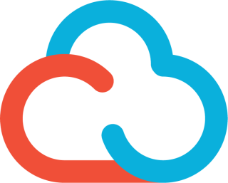


Now - Modernization for Hybrid Clouds via SV
Notes:
Spectrum Virtualize has been in the market for 12 years and is true and tried technology on premises, virtualizing over 400 external types of storage arrays. Now clients can take advantage of this technology in the Public Cloud to both optimize public cloud IaaS, as well as provide Data Services for the replication and migration of data from on premises data centers (no matter what the storage is) to the Public Cloud.

Slide 6
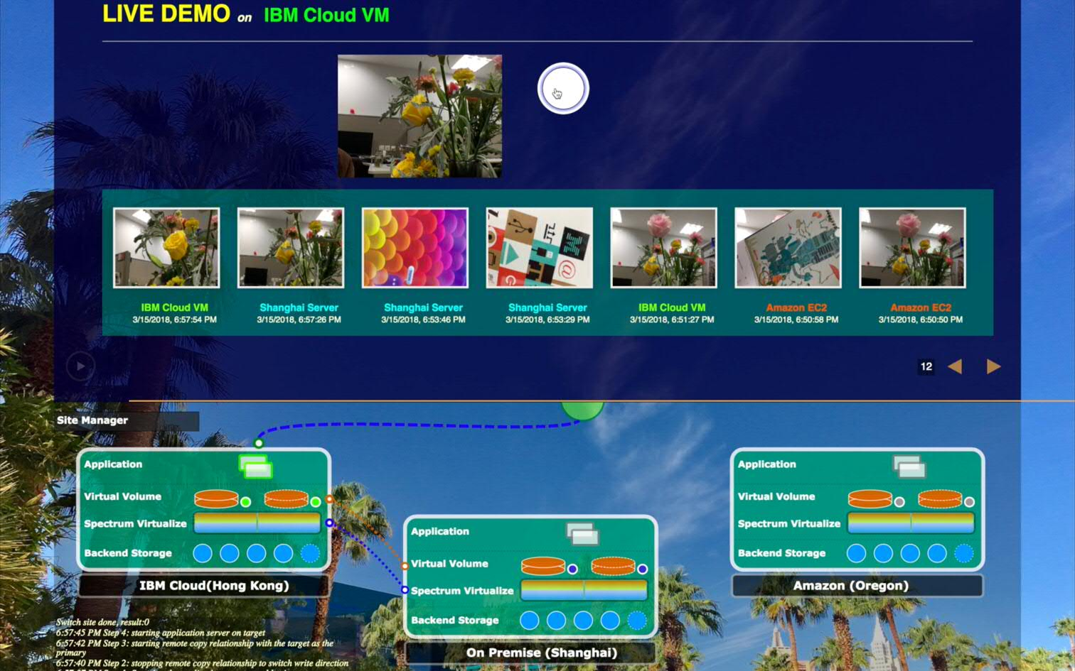

Practice I - Seamlessly Migrating Data Among Clouds
Hong Kong
(Public Cloud)
Shanghai
(On-Premise)
Oregon
(Public Cloud)
Notes:
Today we’re showing how data can be transferred from on premises to a public cloud through Asynchronous replication. This is to demonstrate the capability of Zero or Near-Zero data loss for clients seeking very low RPO and RTO solutions for disaster recovery and disaster avoidance. There are different types of solutions available to clients when it comes to Data Protection and Disaster Recovery, but each type of solution has different capabilities in terms of satisfying Recovery Point Objectives and Recovery Time Objectives. For example, clients running an Oracle workload who archive data to a cold storage tier (such as Cloud Object Storage) cannot run a production environment against Object Storage…for an Oracle database. In order to recover their environment, they would need to first rehydrate that data into block storage (either on premises or in the cloud) and then bring up their database. This takes time – probably days. For clients that want to be able to have the MOST up to date data on their secondary site, and be able to RECOVER applications (either Virtualized or Physical applications) in minutes, storage based replication of data over IP is the implementation that can achieve almost instantaneous (or synchronous) availability of the data in case of disaster. Distance, performance, and cost are all factors in choosing the right Business Resiliency solution. A hot site stores data in the same format in the cloud as it does on premises, allow applications to directly use that data in case of a disaster at the primary location.

Slide 7



Practice II – Then, what about applications?
On-Premise(Su Zhou)
Public cloud(HK)
Vmware vCenter
VMware SRM + SRA
Vmware vCenter
VMware SRM + SRA
vSphere Server
vSphere Server
vSphere Server
vSphere Server
vSphere Server
vSphere Server
Physical SV Storage
IP Replication
Spectrum Virtualize
Notes:
Today we’re showing how data can be transferred from on premises to a public cloud through Asynchronous replication. This is to demonstrate the capability of Zero or Near-Zero data loss for clients seeking very low RPO and RTO solutions for disaster recovery and disaster avoidance. There are different types of solutions available to clients when it comes to Data Protection and Disaster Recovery, but each type of solution has different capabilities in terms of satisfying Recovery Point Objectives and Recovery Time Objectives. For example, clients running an Oracle workload who archive data to a cold storage tier (such as Cloud Object Storage) cannot run a production environment against Object Storage…for an Oracle database. In order to recover their environment, they would need to first rehydrate that data into block storage (either on premises or in the cloud) and then bring up their database. This takes time – probably days. For clients that want to be able to have the MOST up to date data on their secondary site, and be able to RECOVER applications (either Virtualized or Physical applications) in minutes, storage based replication of data over IP is the implementation that can achieve almost instantaneous (or synchronous) availability of the data in case of disaster. Distance, performance, and cost are all factors in choosing the right Business Resiliency solution. A hot site stores data in the same format in the cloud as it does on premises, allow applications to directly use that data in case of a disaster at the primary location.

Slide 8
Questions?

